Slide 1
GANs on Graph
Yuchen Yan
2020.03.18

Slide 2
Outline
GraphGAN[1] (AAAI2018)
CommunityGAN[2] (WWW2019,Optional)

Slide 3
Part 1:GraphGAN

Slide 4
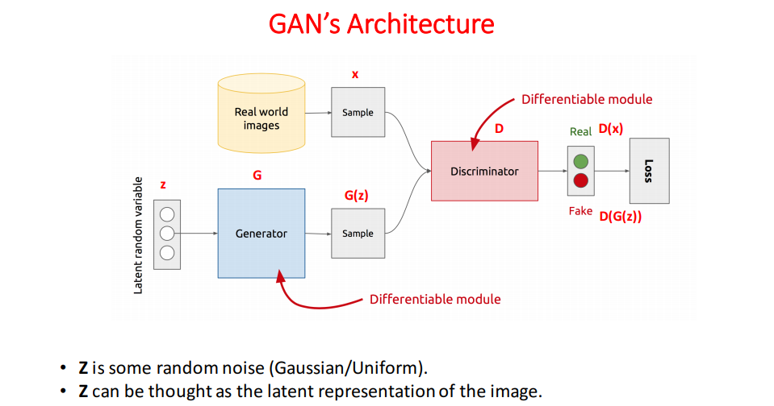
GAN

Slide 5
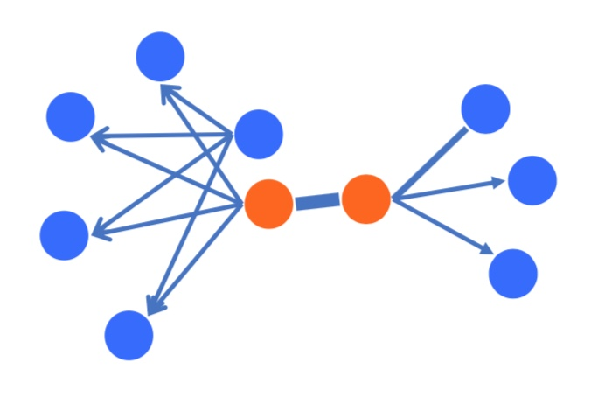
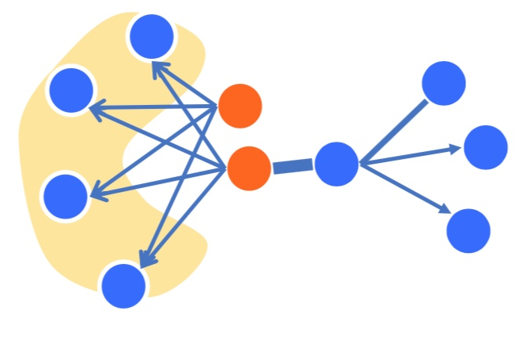


Generative Model & Discriminative Model
Similar to LINE[3] to some extent but actually different thing
$$p(edge|v_{i},v_{j})$$
$$p_{true}(v|v_{c})$$
Discriminative Model
Generative Model

Slide 6
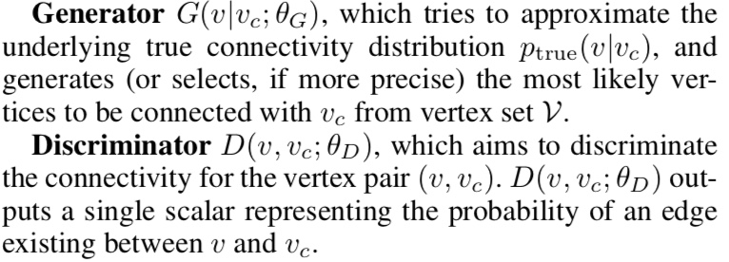
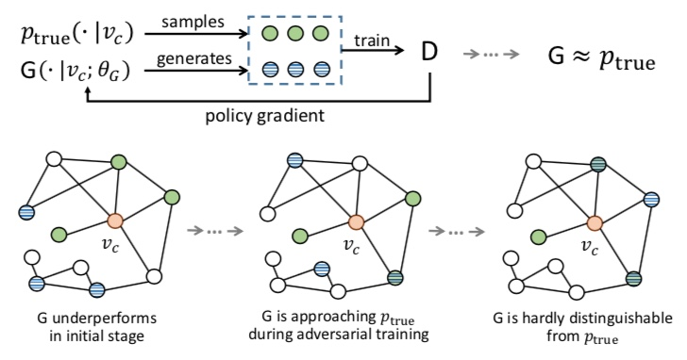
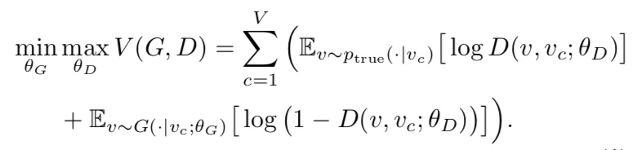
How to combine Generative & Discriminative model

Slide 7
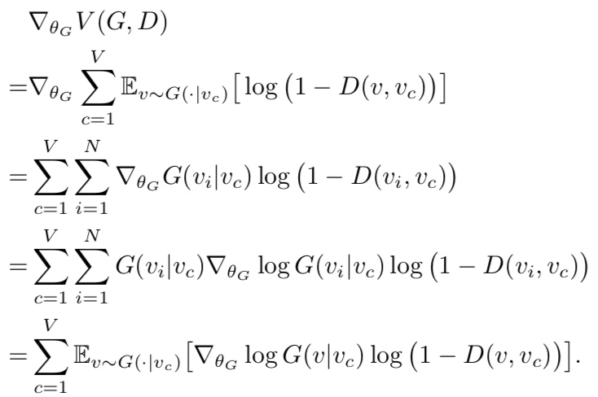
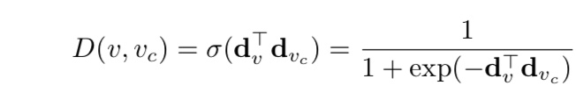
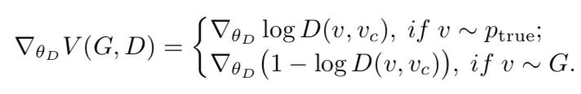

G and D Optimization
Value Function $V\left(G,D\right)$
The gradient for G
A simple implementation of D
The gradient for D

Slide 8
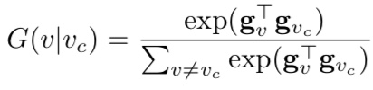
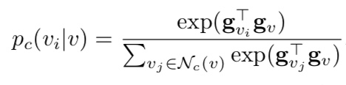


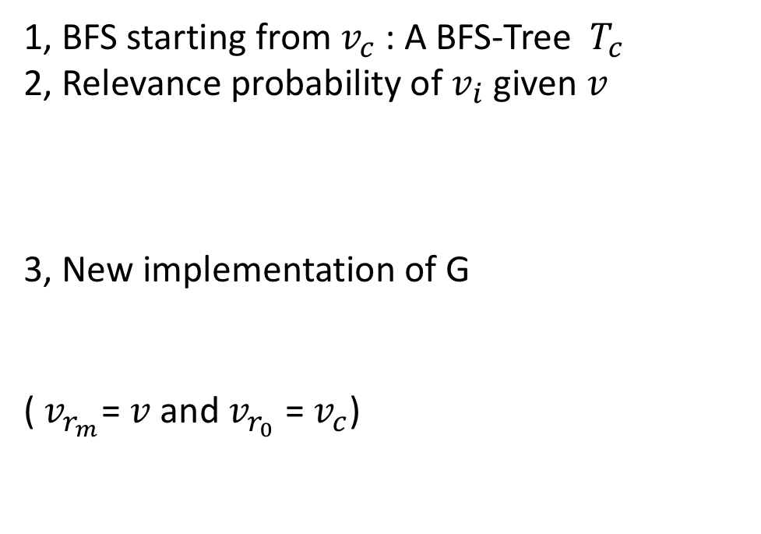
Graph Softmax
A simple implementation of G : Just a softmax
1, BFS starting from $v_{c}$ : A BFS-Tree $T_{c}$
2, Relevance probability of $v_{i}$ given $v$
3, New implementation of G
($v_{r_{m}}$=$v$ and $v_{r_{0}}$ = $v_{c}$)
Problem:
1, Ignore structure information by treating all vertices equally
2, Computationally inefficient
Requirements for Graph Softmax
1, Normalized probability:
2, Graph-Structure-Aware :for two vertices in a graph their connectivity probability should decline with the increase of their shortest distance
3, Computationally efficient

Slide 9
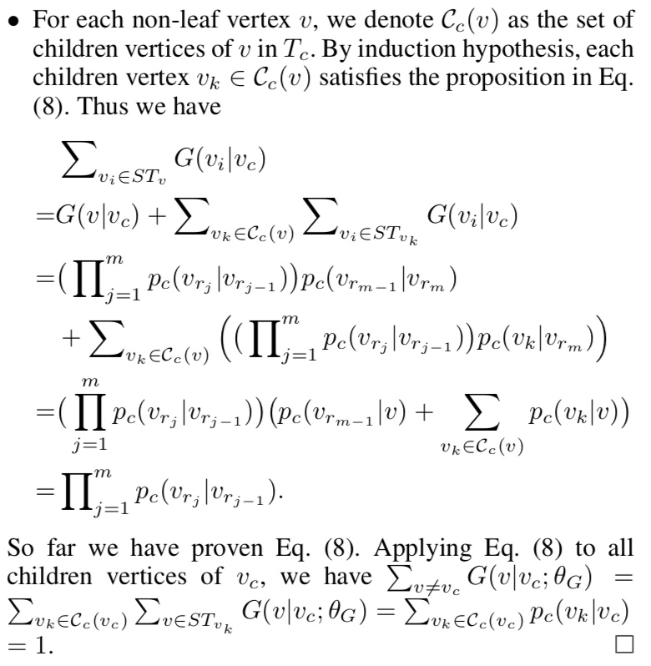
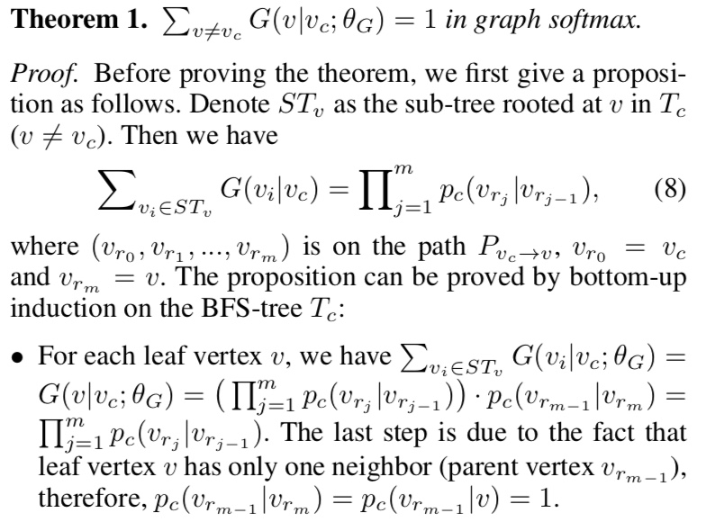
Normalized Requirement

Slide 10
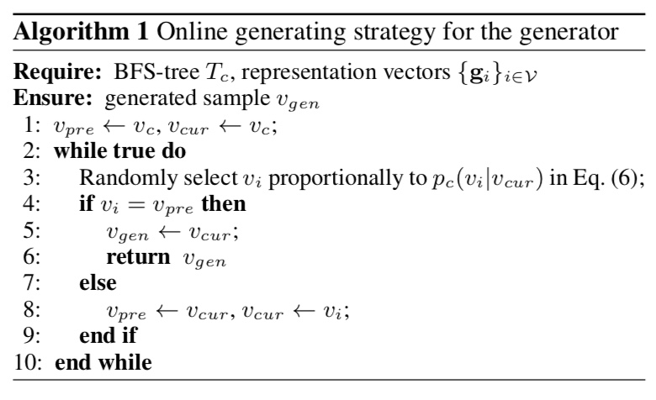
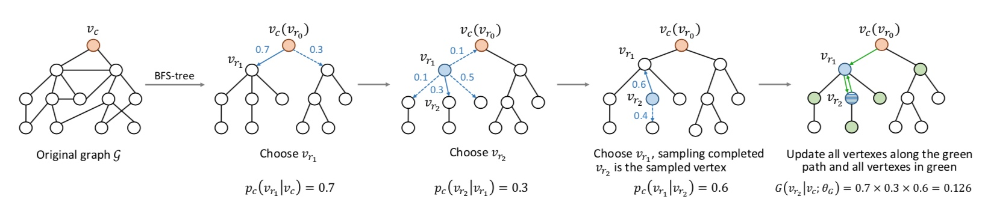
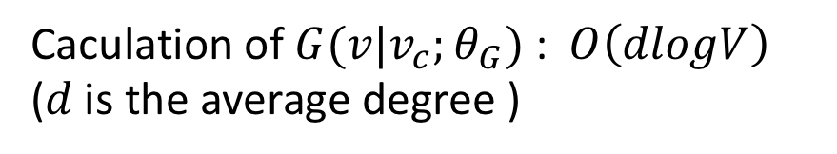
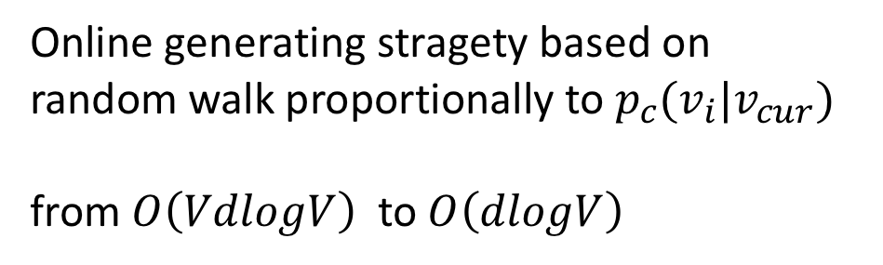
Computation Requirement
Caculation of $G(v|v_{c};θ_{G})$ : $O\left(dlogV\right)$ ($d$ is the average degree )
Online generating stragety based on random walk proportionally to $p_{c}(v_{i}|v_{cur})$
from$O\left(VdlogV\right)$ to $O\left(dlogV\right)$

Slide 11
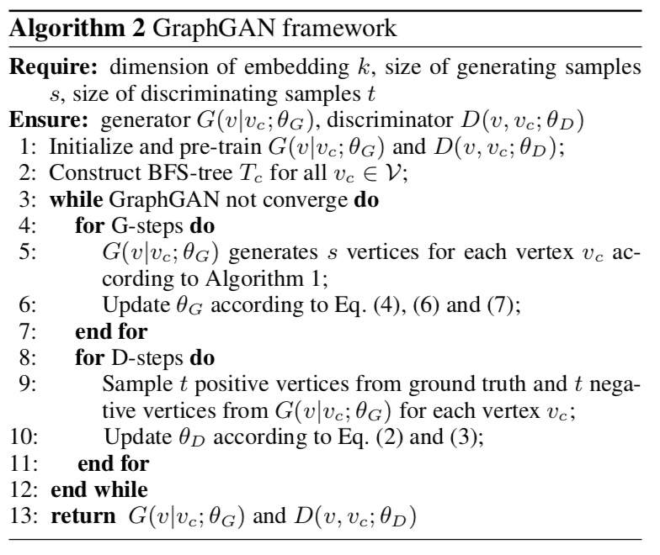
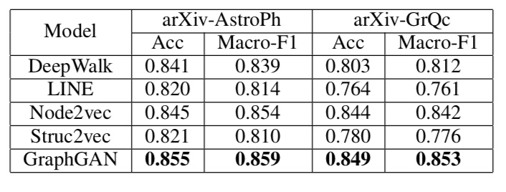
Results and Thought
Link Prediction Result
What is GraphGAN in nature ? What works behind it?
Just the shortest distance random walk pattern ! It is most important ! Let’s go to CommunityGAN to see another pattern !

Slide 12
Part 2:CommunityGAN(Optional)

Slide 13
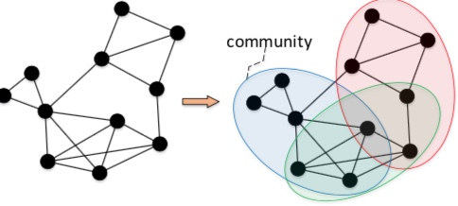
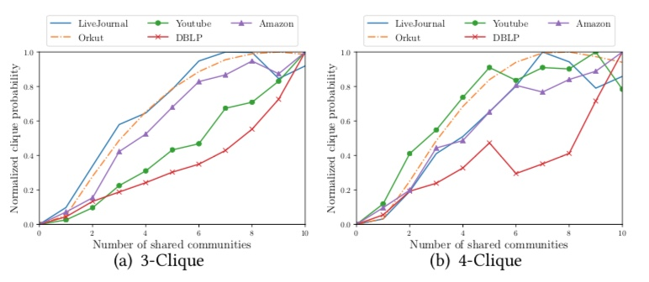
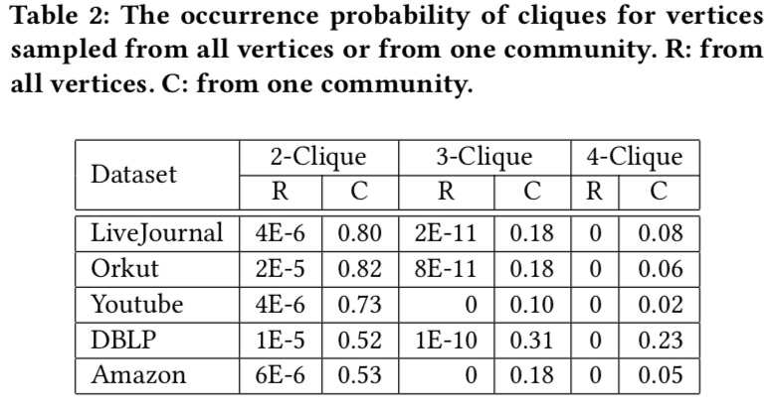
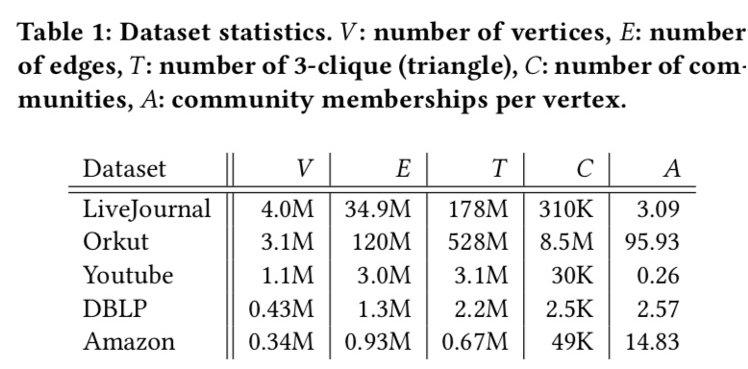
Community Detection: Dense Overlapping problem One node may belong to a lot of communities
Observation : Clique !!!
Traditional Clustering can not solve

Slide 14
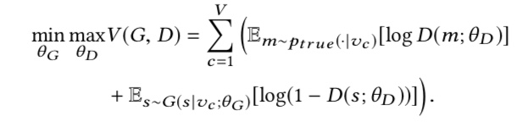
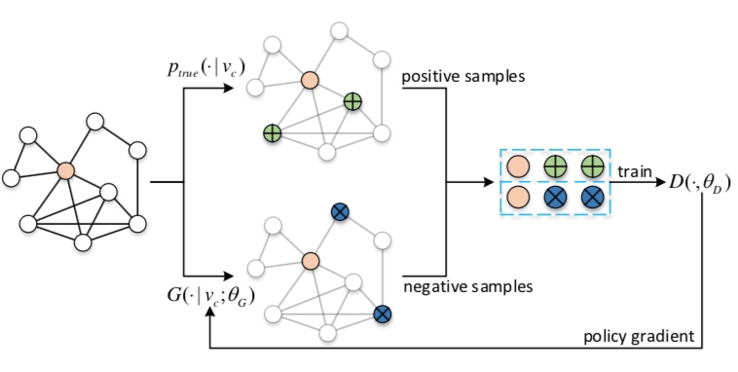
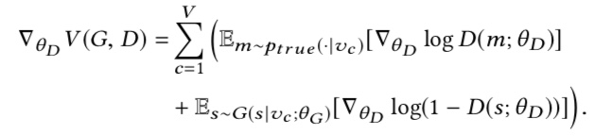
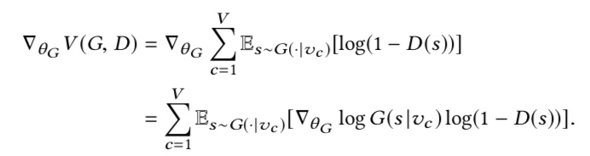
Same Idea as GraphGAN
From edge generation to clique generation
Similar Formula

Slide 15



Naïve implementation
Similar to GraphGAN
Problem:
1, Just clique prediction
No interpretation for community detection
2, No graph structure information
3, Computationally Inefficient
And

Slide 16

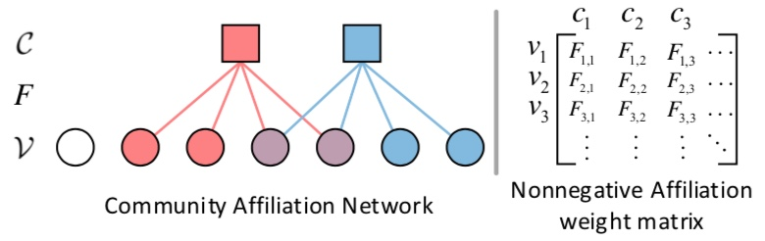
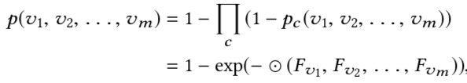
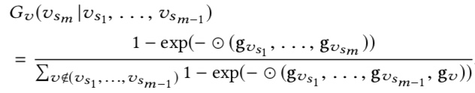
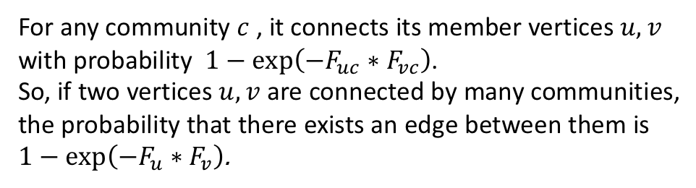
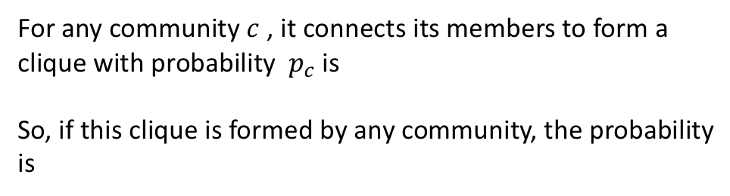
AGM[4]
For any community $c$ , it connects its members to form a clique with probability $p_{c}$ is
So, if this clique is formed by any community, the probability is
For any community $c$ , it connects its member vertices $u,v$ with probability $1−\exp\left(−F_{uc}∗F_{vc}\right)$.
So, if two vertices $u,v$ are connected by many communities, the probability that there exists an edge between them is $1−\exp\left(−F_{u}∗F_{v}\right)$.
New D and new G

Slide 17
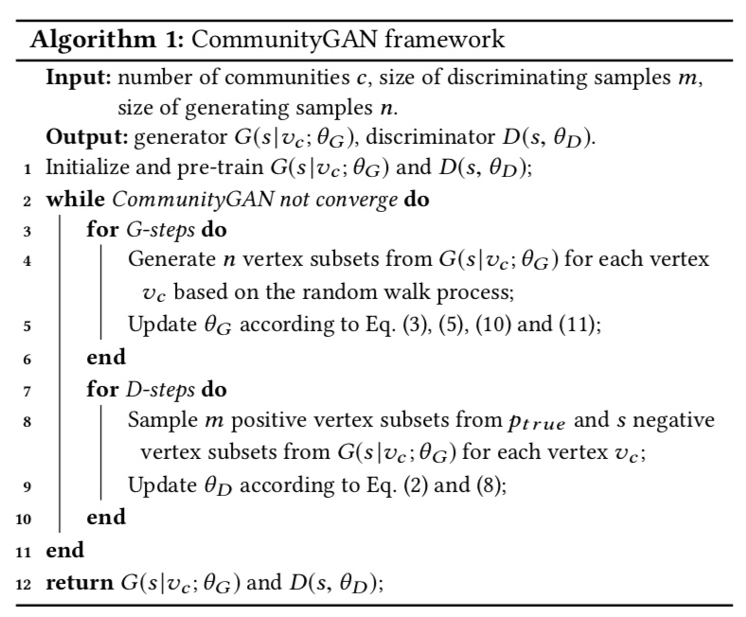

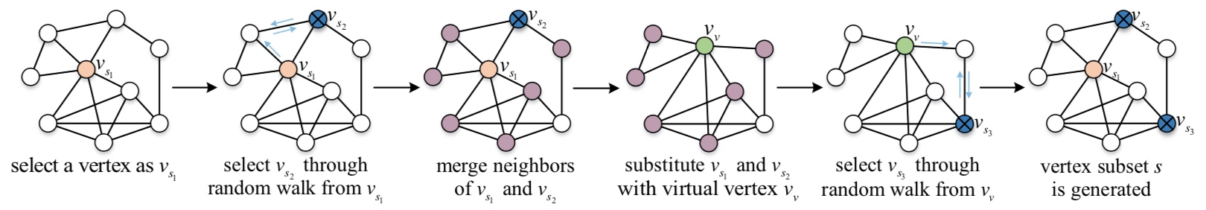
Implementation
Introduce virtual node:

Slide 18

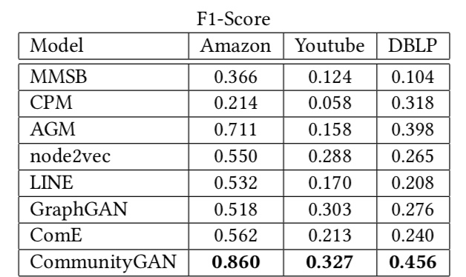
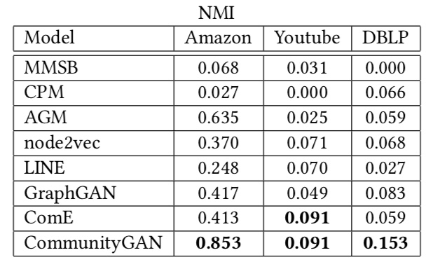
Results and Thought
The performance is quite strong

Slide 19
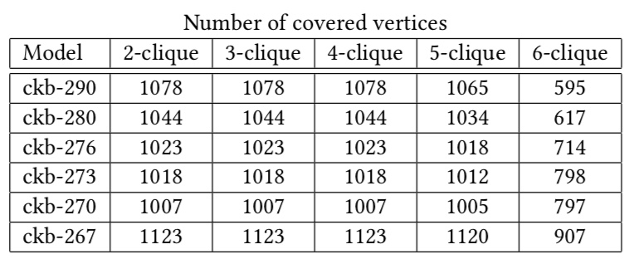
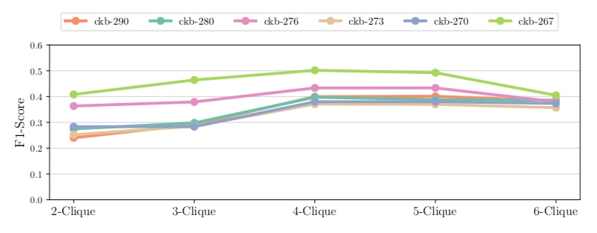
Results and Thought
The right pattern is most important, GAN is just a tool or a story for the reviewer.

Slide 20
Reference
[1] Wang H, Wang J, Wang J, et al. Graphgan: Graph representation learning with generative adversarial nets[C]//Thirty-second AAAI conference on artificial intelligence. 2018.
[2] Jia Y, Zhang Q, Zhang W, et al. Communitygan: Community detection with generative adversarial nets[C]//The World Wide Web Conference. 2019: 784-794.
[3] Tang J, Qu M, Wang M, et al. Line: Large-scale information network embedding[C]//Proceedings of the 24th international conference on world wide web. 2015: 1067-1077.
[4] Edo M Airoldi, David M Blei, Stephen E Fienberg, and Eric P Xing. 2009. Mixed membership stochastic blockmodels. In Advances in Neural Information Processing Systems. 33–40.

Slide 21
Thank you.

